Slide 1

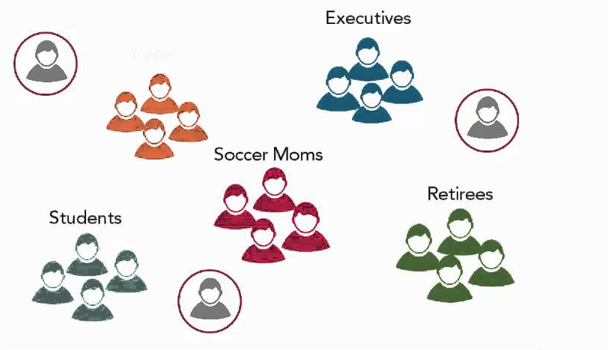
Customer Segmentation
Siddhesh Suresh Kadam
(Intern)

Slide 2
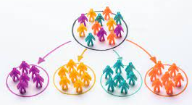
The Hitch
With the world's infinite diversity of individuals and characteristics, a prospective market is rarely singled out or simply defined.
It's critical to understand your target market in order to ensure that your messages are both successful (attractive, action-oriented) and appropriate (non-offensive, timely, and relevant).
As a result, your marketing strategies will become more successful and efficient, saving you time and money while also increasing the rewards.

Slide 3
The Approach
Uncountable potential ways to segment your consumer base.
The particular consumer segmentation model that will be of most benefit your business will also depend on the specifics of your products/services and customer base.
Model we used in this project is the Apriori and Cluster Based Segmentation.

Slide 4
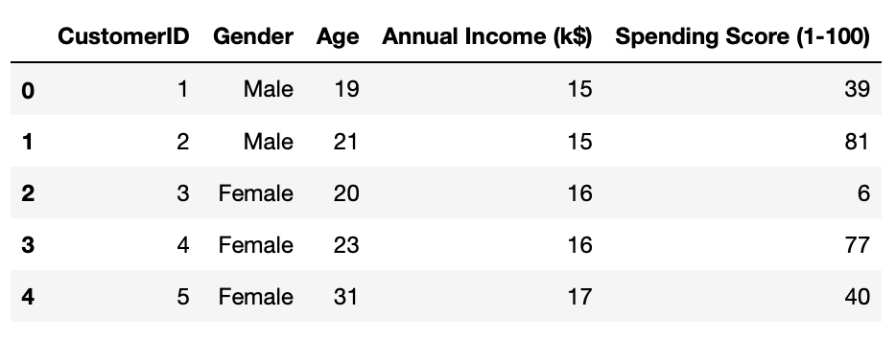
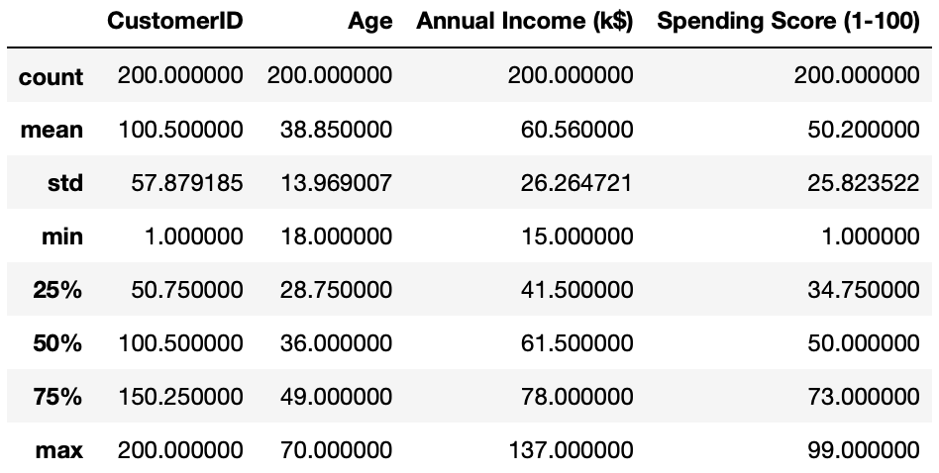
All the attributes of the customer data set are demographic characteristics used in Apriori Segmentation.
We had the data on 200 customers with no null instances.
Some features about the customer data set:
Age Range : 18 - 70
Annual Income Range : 15k$ - 137k$
Men - 44% Women - 56%

Slide 5
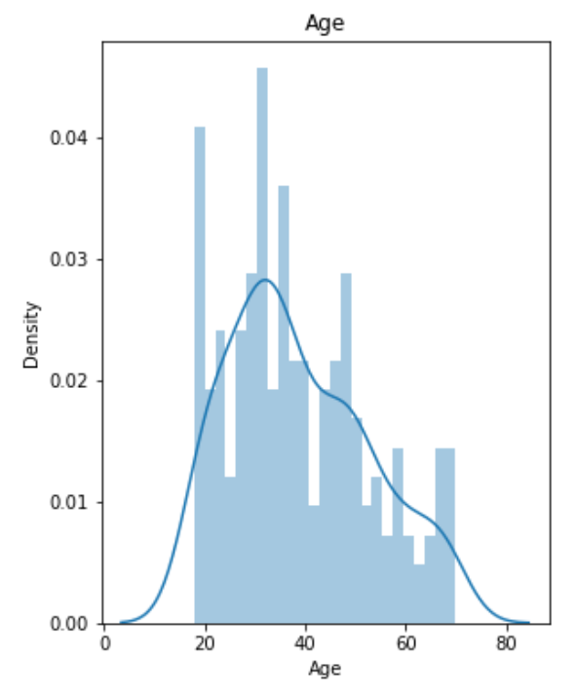
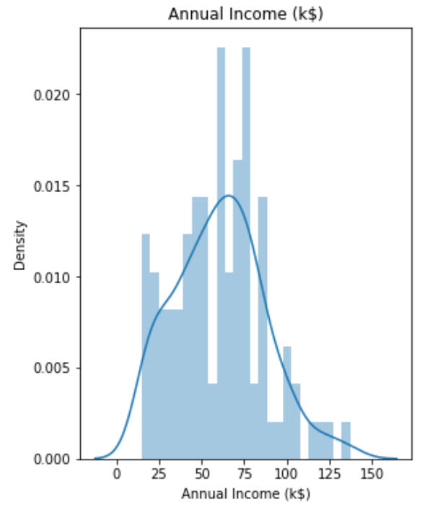
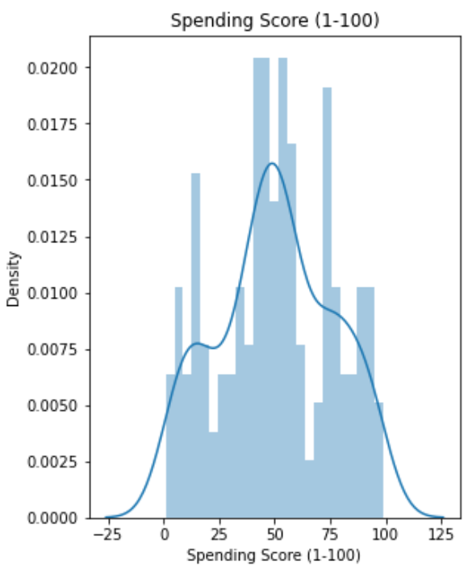
Data Demographics
1
Age Distribution tends towards customers in their mid 20s’ and mid 40s’
Annual Income is densely populated at the mid of the income range.
The inferences from spending score histogram do not portray any strategic information. The graph would seem misleading if the density scaling isn’t taken under consideration.

Slide 6
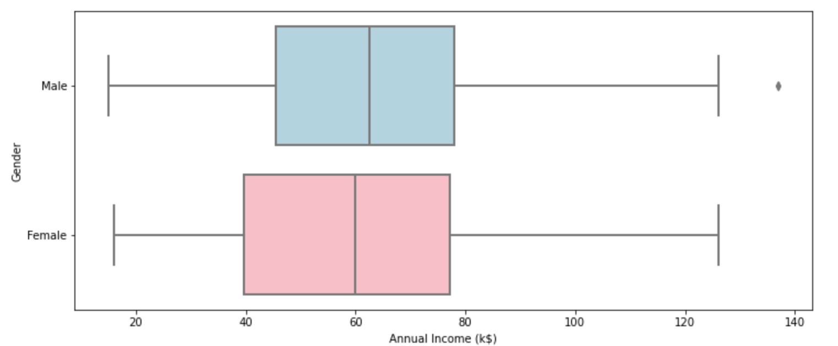
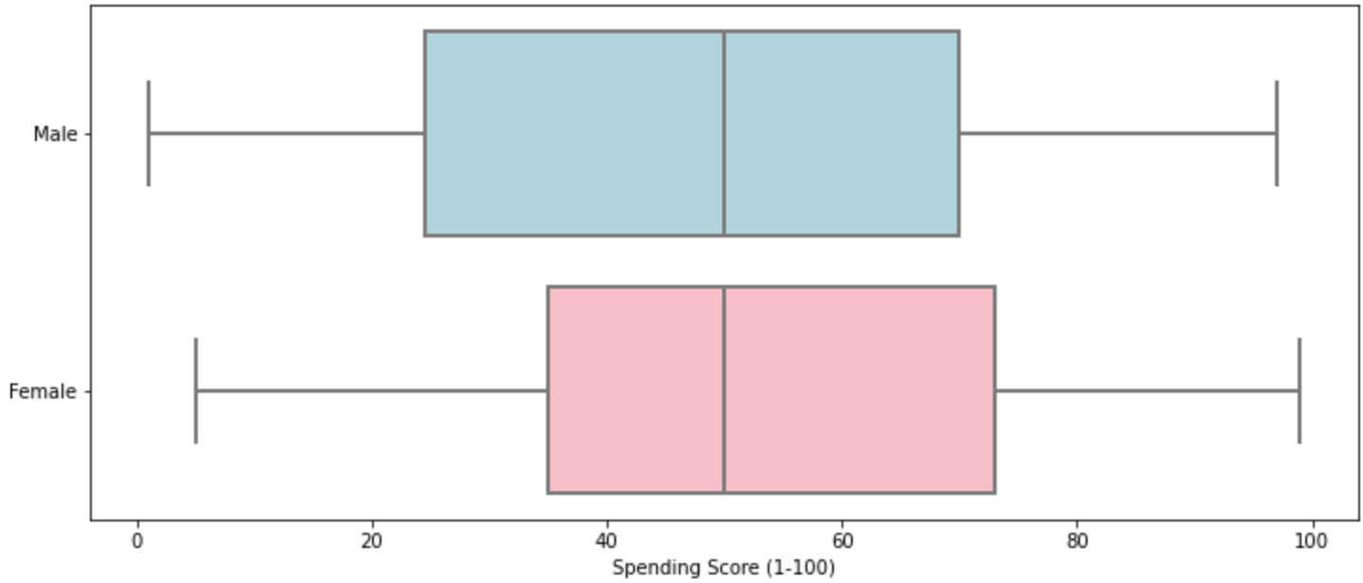
Annual Income and Spending Score for Men and Women
In terms of Annual Income for both men and women, 75th quantile ends at 80k$.
Spending Score median for both men and women is the same, ~50.
However as compared to women, men have relatively lower spending score density.

Slide 7
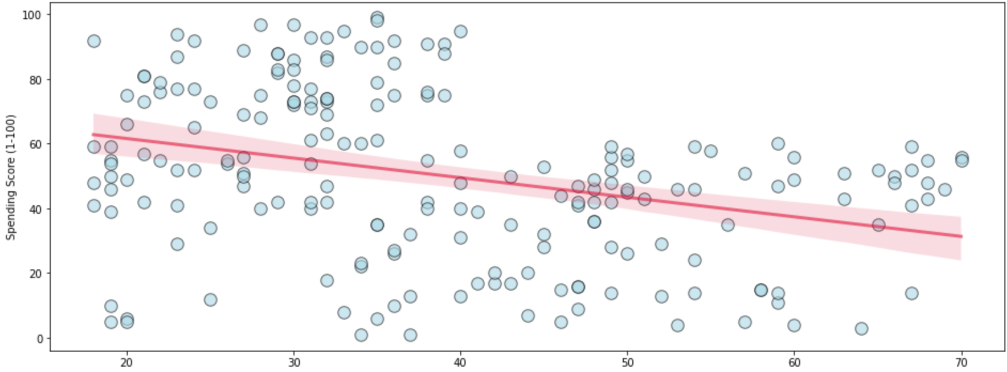
Strong Correlations
Spending Score
Age

Slide 8
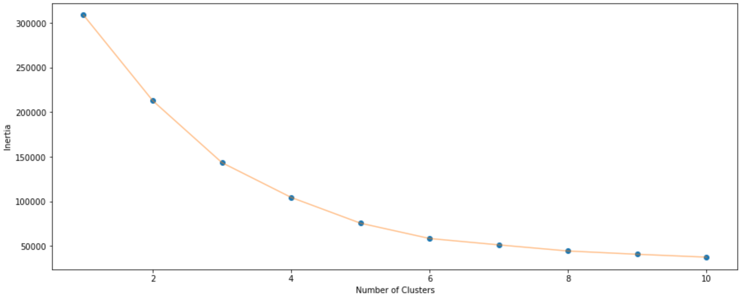
In our case the optimal value tends out to be 6. Any value higher than this will cause the model to overfit. After getting this value we train the data over the KMeans cluster algorithm with K=6.
Inertia
Clusters

Slide 9
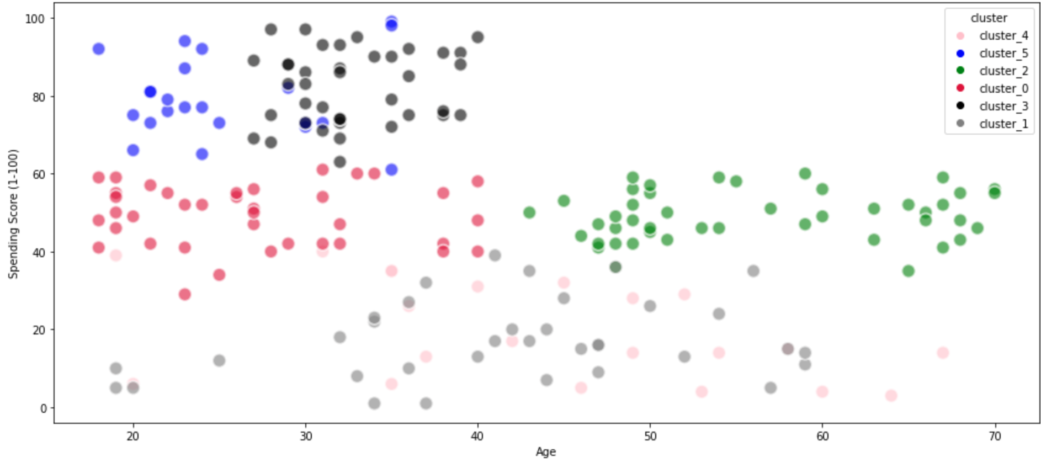
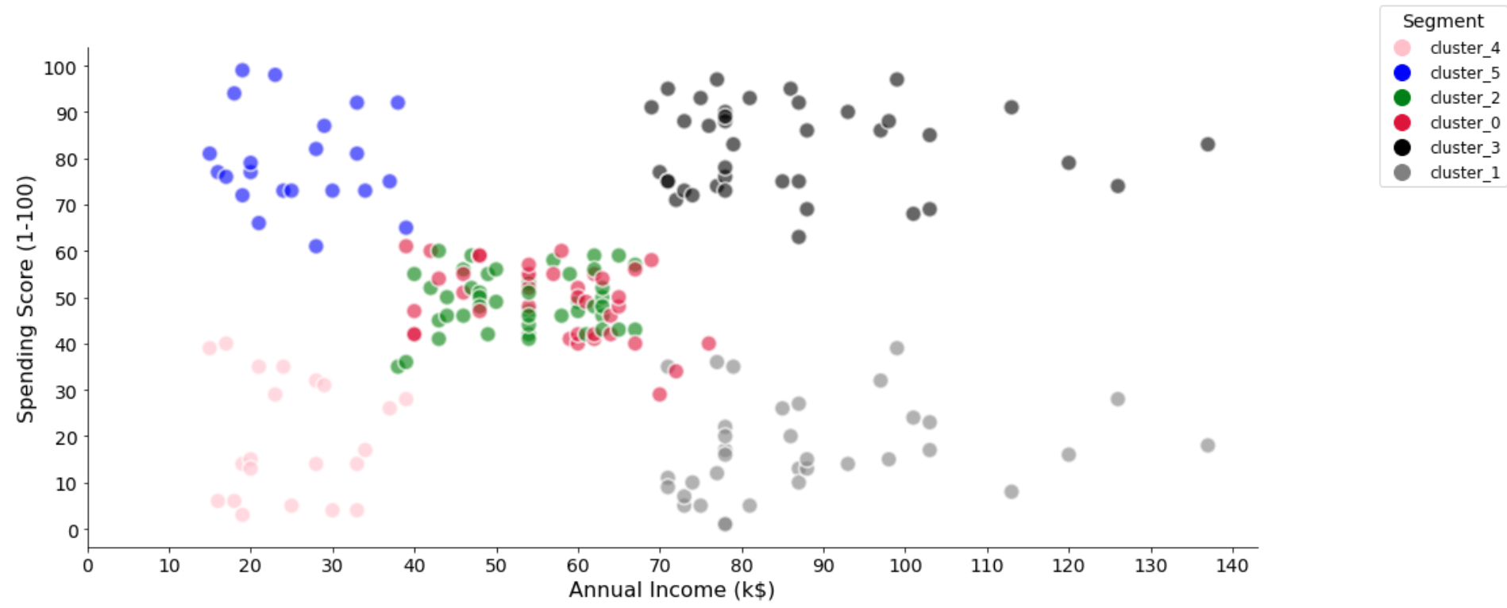
Spending Score and Age
Spending Score and Annual Income

Slide 10
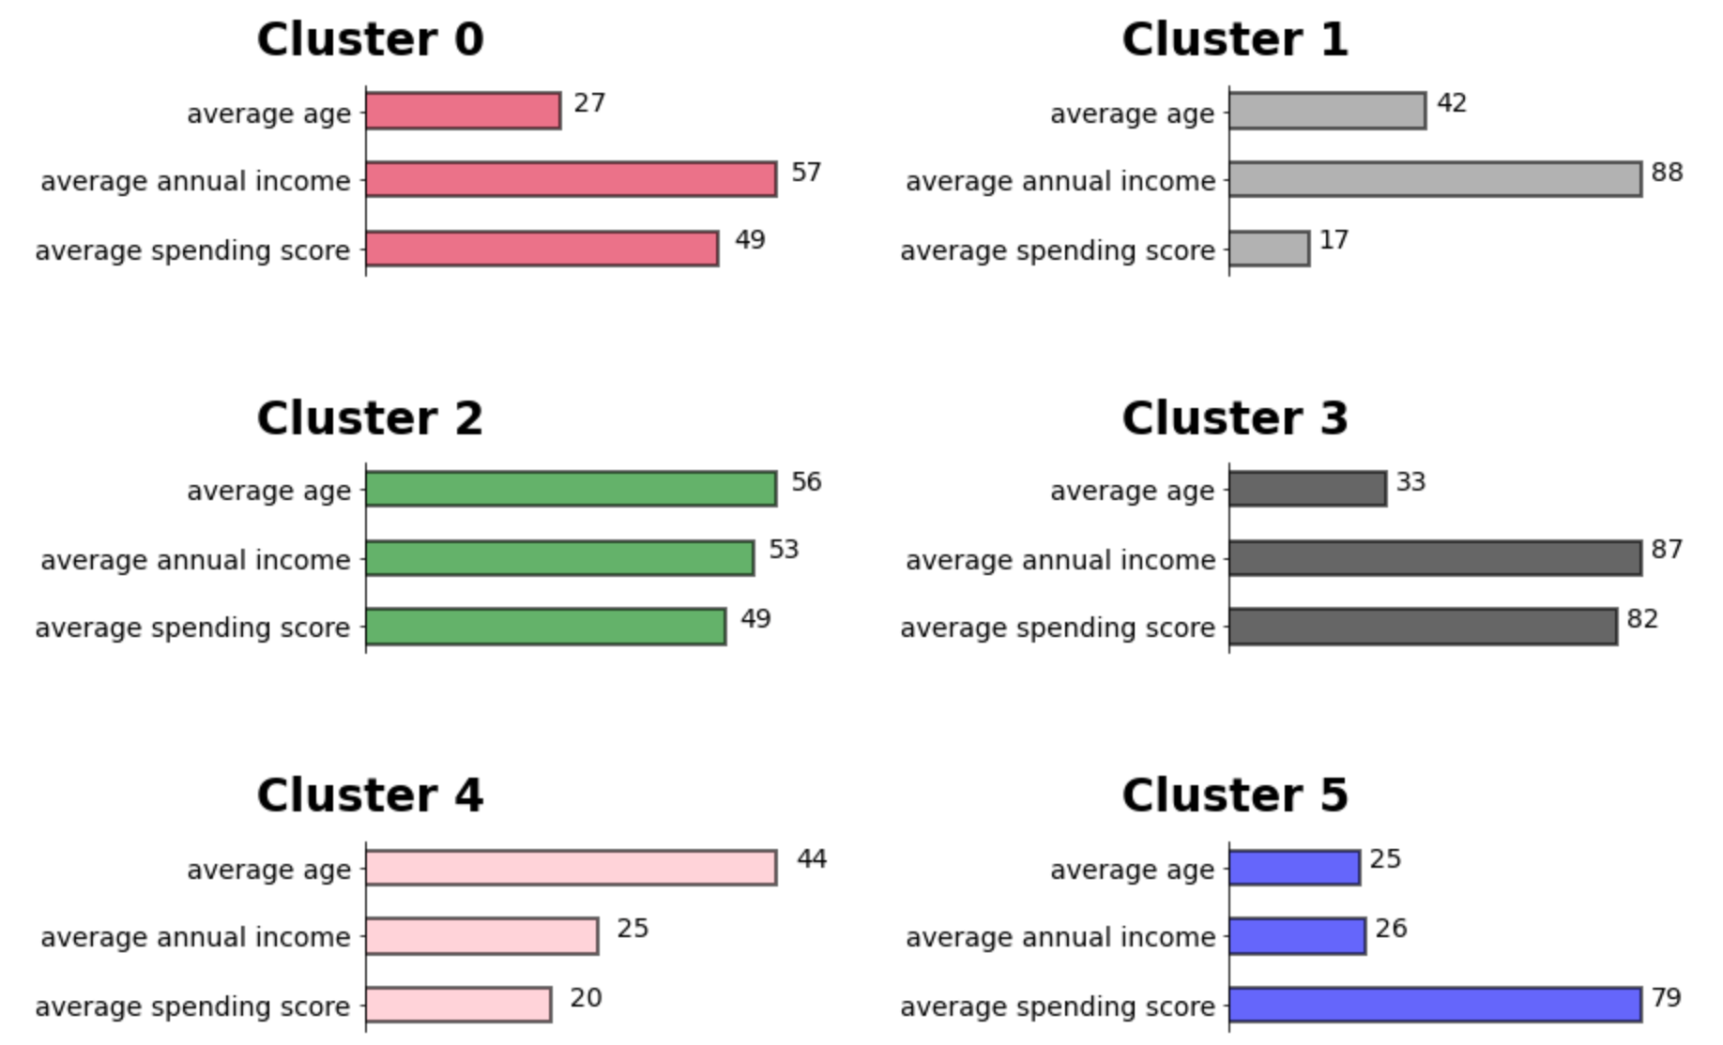
Clusters Demographics

Slide 11
Thank You!

